Slide 1
12. Deep Learning

Slide 2
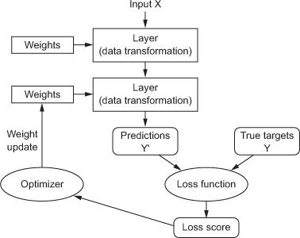
Anatomy of a deep neural network
Layers
Input data and targets
Loss function
Optimizer

Slide 3
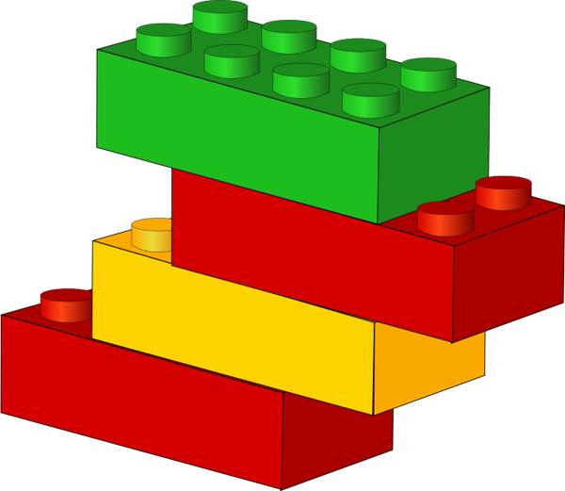
Layers
Data processing modules
Many different kinds exist
densely connected
convolutional
recurrent
pooling, flattening, merging, normalization, etc.
Input: one or more tensors output: one or more tensors
Usually have a state, encoded as weights
learned, initially random
When combined, form a network or a model
(Tensors are multi-dimensional arrays with a uniform type).

Slide 4
Input data and targets
The network maps the input data X to predictions Y′
During training, the predictions Y′ are compared to true targets Y using the loss function

Slide 5
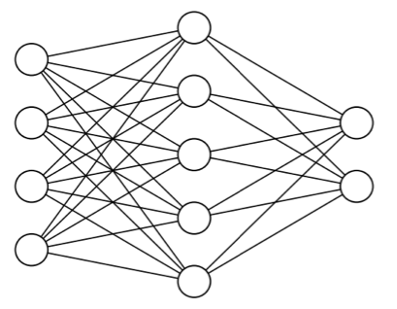

Input data and targets
cat
dog

Slide 6
Optimizer
How to update the weights based on the loss function
Learning rate (+scheduling)
Stochastic gradient descent, momentum, and their variants

Slide 7
Networks as a complex function
A nonlinear activation function g_{j}
Each unit has an extra input from a dummy unit 0 that is fixed to +1 and a weight W_{0,j}
This allows the total weighted input to unit j to be nonzero even when the outputs of the preceding layer are all zero
The non-linearity is what allows sufficiently large networks of units to represent arbitrary functions

Slide 8
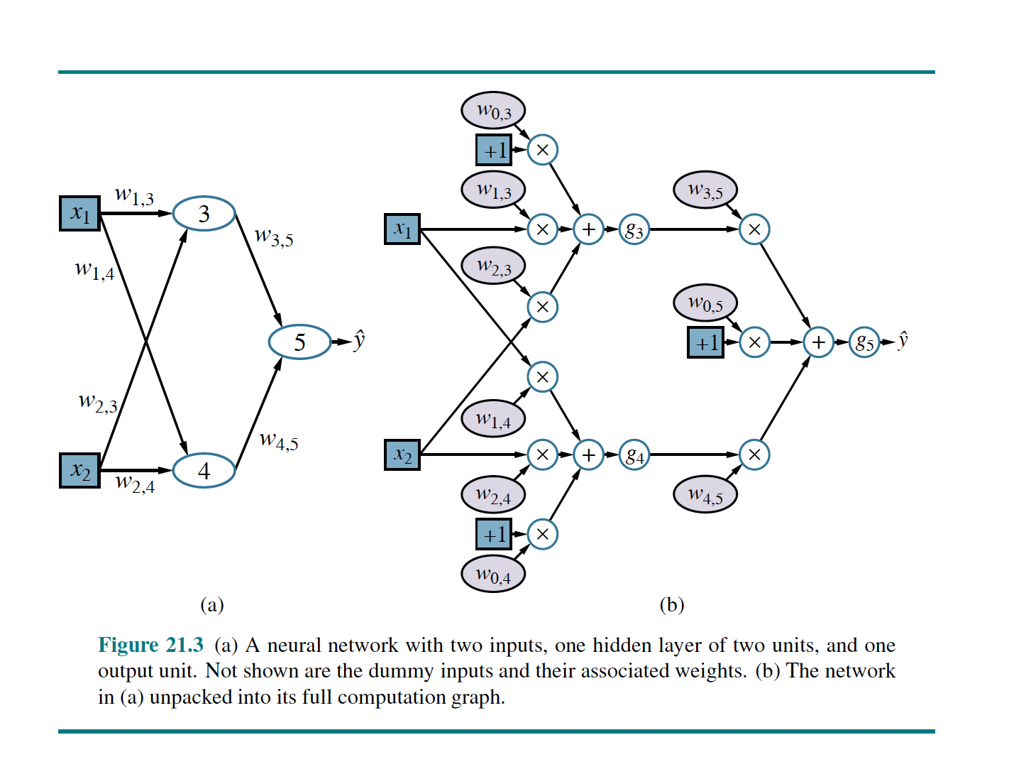
NN with two inputs

Slide 9
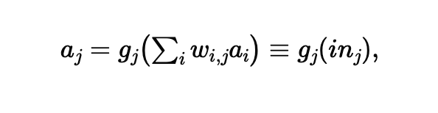
Each unit
Each node within a network is called a unit.
Traditionally, following the design proposed by McCulloch and Pitts,
a unit calculates the weighted sum of the inputs from predecessor nodes and then applies a nonlinear function to produce its output.

Slide 10
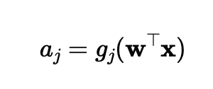
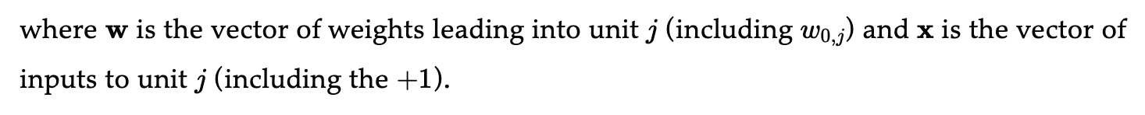
Dummy unit
Allows
Total weighted input to unit 𝑗 to be nonzero even when the outputs of the preceding layer are all zero.

Slide 11
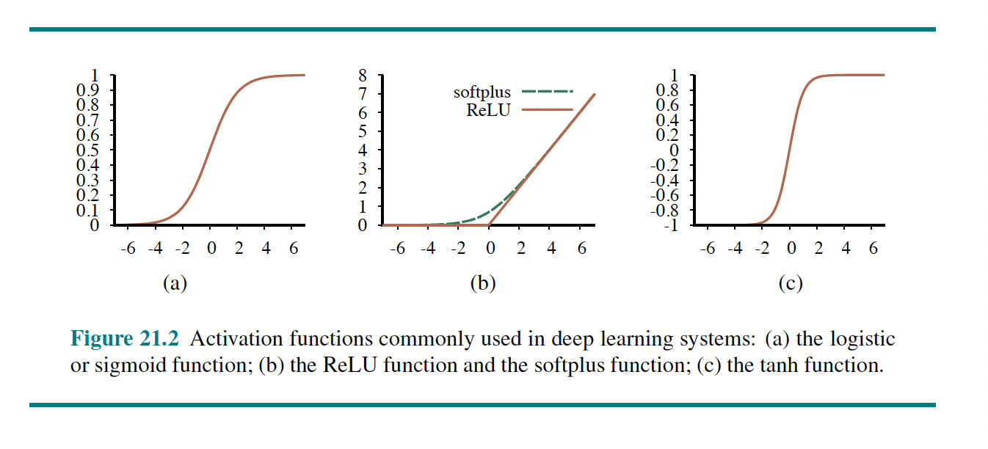
Activation Functions

Slide 12
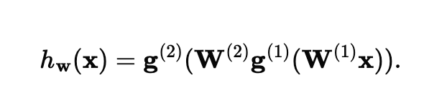
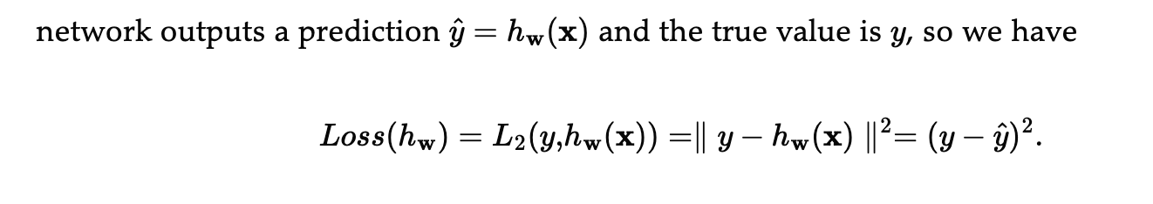
The entire network expression and Loss function

Slide 13

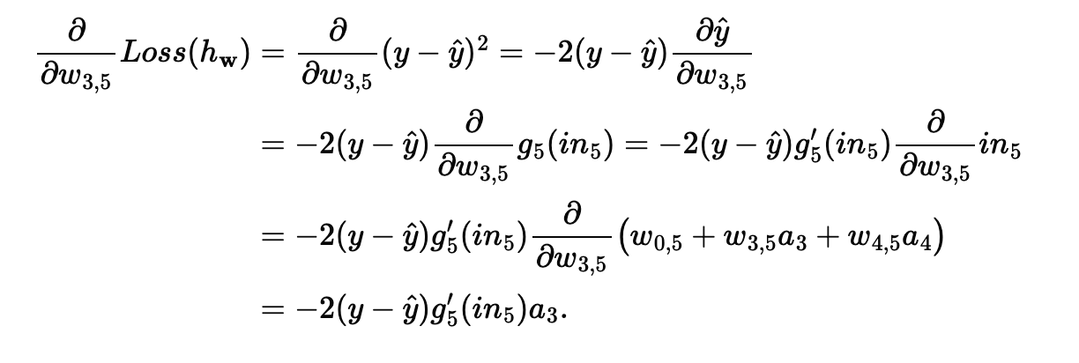
The gradient of Loss
The gradient of loss w.r.t weights using the chain rule

Slide 14
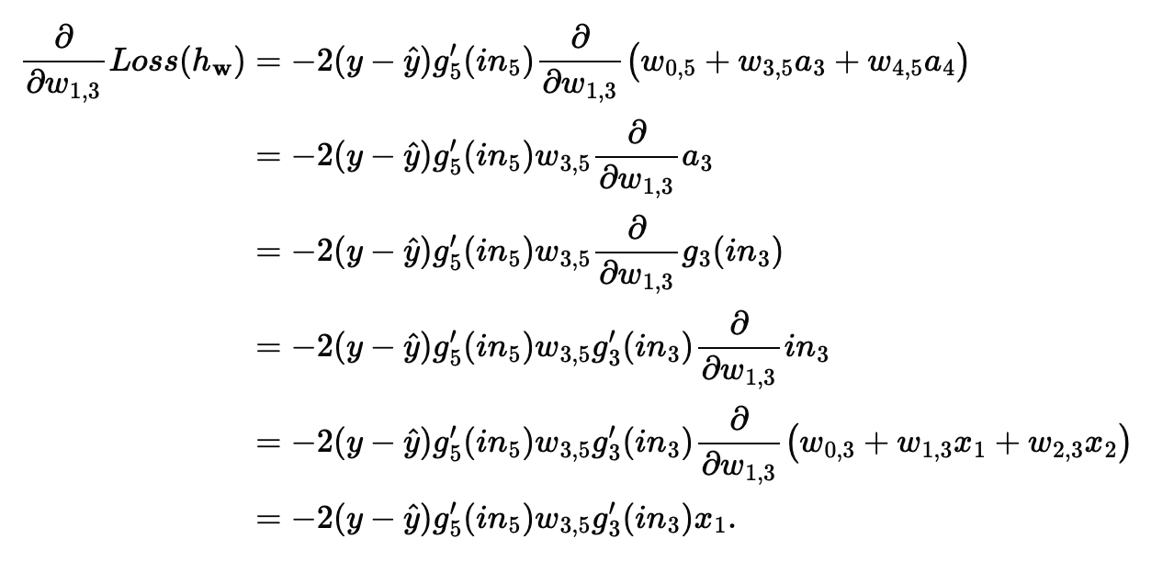
The gradient of loss w.r.t weights

Slide 15
Perceived error in each node
The perceived error at unit 5
The perceived error at unit 3

Slide 16
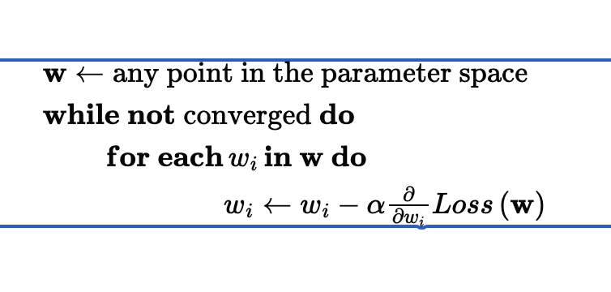
Gradient decent
Repeat until conversing on a point in weight space
by incrementally modifying the parameters

Slide 17
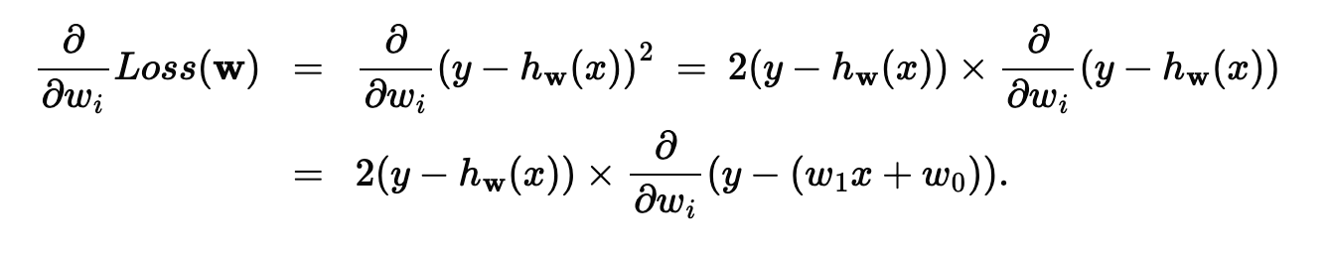
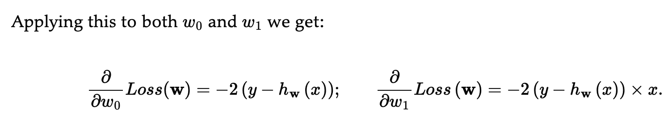

Slide 18

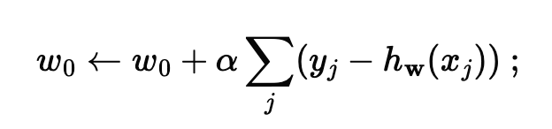
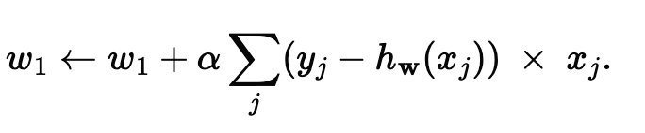

Slide 19
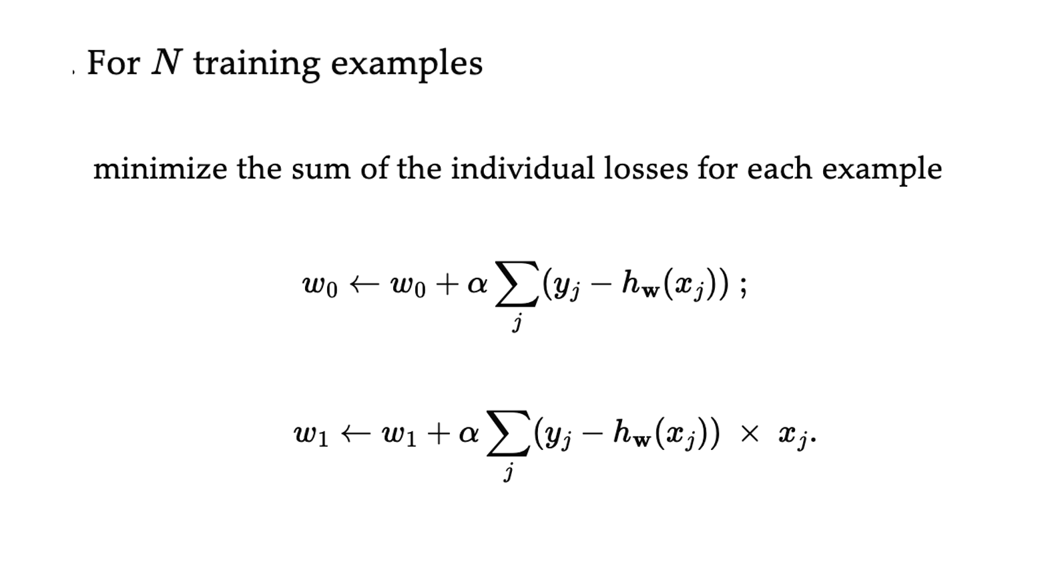
Batch Gradient Descent

Slide 20
InClass Exercise: Gradient descent
Loss function y = 2x² - 6x + 1
With a parameter x
Step size = slope * learning rate
New value = old value – step size
For example, new_x = old_x – stepsize
Find the parameter, x, that gives a minimum value of y (i.e., loss function)
Assume the initial x = 4
A) Do for the learning rate = 0.2
B) Redo for learning rate = 0.1

Slide 21
The error surface for a linear neuron
The error surface lies in a space with a horizontal axis for each weight and one vertical axis for the error.
For a linear neuron with a squared error, it is a quadratic bowl.
Vertical cross-sections are parabolas.
Horizontal cross-sections are ellipses.
For multi-layer, non-linear nets the error surface is much more complicated.
But locally, a piece of a quadratic bowl is usually a very good approximation.
E
w1
w2

Slide 22
Parabolas
In mathematics, a parabola is a plane curve which is mirror-symmetrical and is approximately U-shaped.

Slide 23
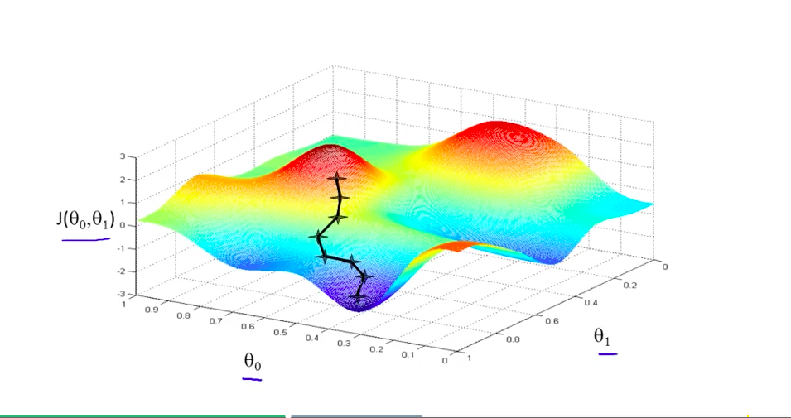
Example

Slide 24
How the learning goes wrong
If the learning rate is big, the weights slosh to and from across the ravine.
If the learning rate is too big, this oscillation diverges.
What we would like to achieve:
Move quickly in directions with small but consistent gradients.
Move slowly in directions with big but inconsistent gradients.
E
w

Slide 25
Stochastic gradient descent
Use a randomly selected subset of the data at every step rather than the full dataset

Slide 26
Online Stochastic gradient descent
If the dataset is highly redundant, the gradient on the first half is almost identical to the gradient on the second half.
So instead of computing the full gradient, update the weights using the gradient on the first half and then get a gradient for the new weights on the second half.
The extreme version of this approach updates weights after each case. Its called “online”.

Slide 27
Mini-batches Stochastic gradient descent
Mini-batches are usually better than online.
Less computation is used updating the weights.
Computing the gradient for many cases simultaneously uses matrix-matrix multiplies which are very efficient, especially on GPUs
Mini-batches need to be balanced for classes
Select m examples out of N examples in each step

Slide 28
In practice
For large neural networks with very large and highly redundant training sets, it is nearly always best to use mini-batch learning.
The mini-batches may need to be quite big
Big mini-batches are more computationally efficient.

Slide 29
Gradient Descent (GD) Algorithm
Gradient descent algorithm stops when a local minimum of the loss surface is reached
GD does not guarantee reaching a global minimum
However, empirical evidence suggests that GD works well for NNs

Slide 30
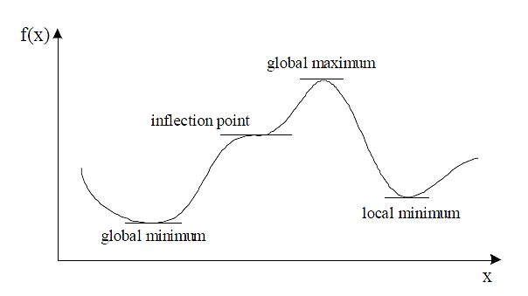
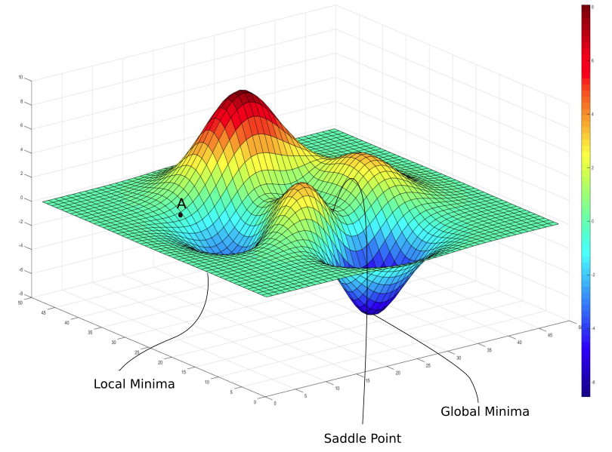


Gradient Descent Algorithm
$ℒ\left(θ\right)$
$$θ$$

Slide 31
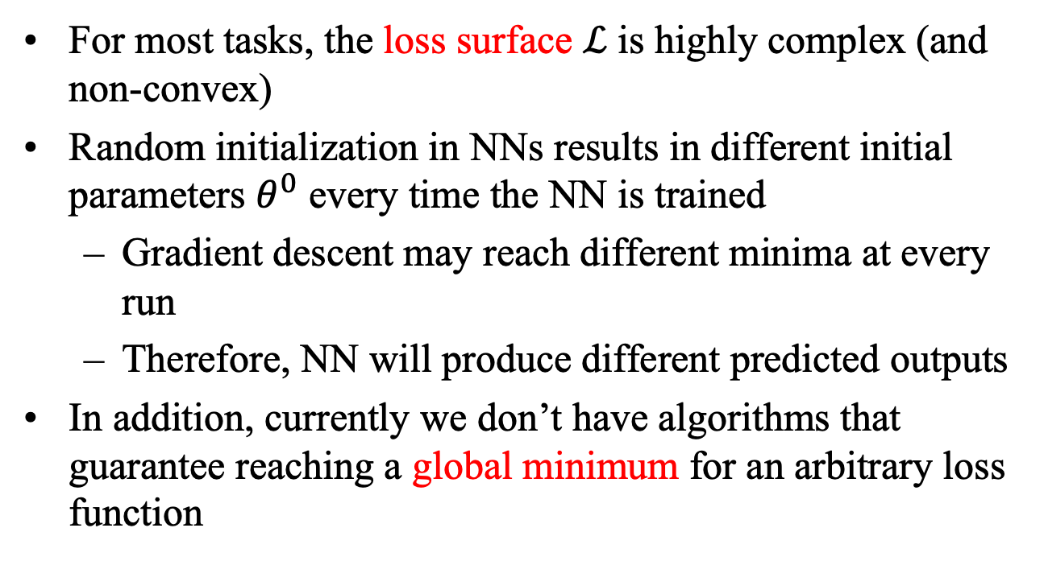
Gradient Descent Algorithm
For most tasks, the loss surface $ℒ$ is highly complex (and non-convex)
Random initialization in NNs results in different initial parameters $θ^{0}$ every time the NN is trained
Gradient descent may reach different minima at every run
Therefore, NN will produce different predicted outputs
In addition, currently we don’t have algorithms that guarantee reaching a global minimum for an arbitrary loss function

Slide 32
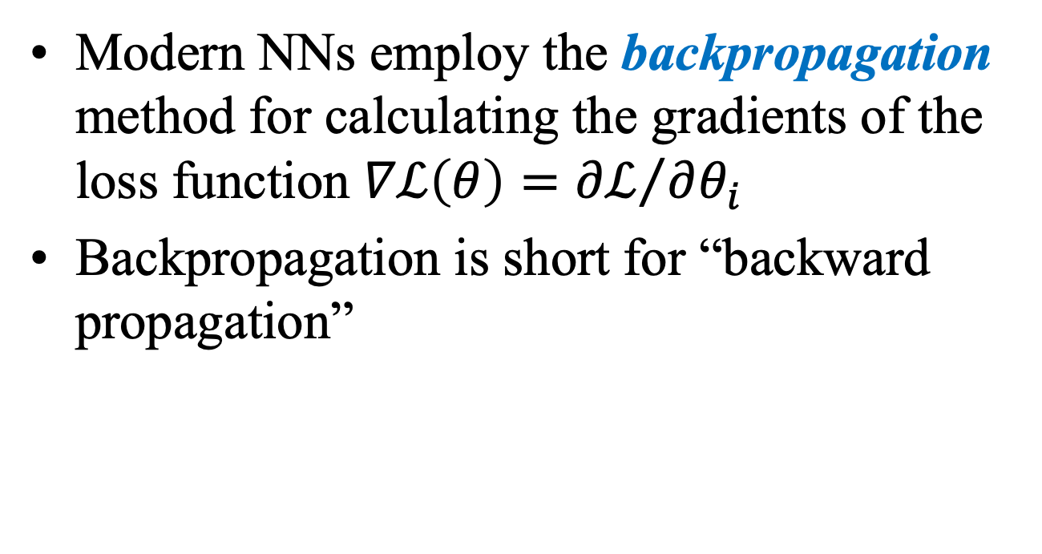
Backpropagation
Modern NNs employ the backpropagation method for calculating the gradients of the loss function $∇ℒ\left(θ\right)={∂ℒ}/{∂θ_{i}}$
Backpropagation is short for “backward propagation”

Slide 33
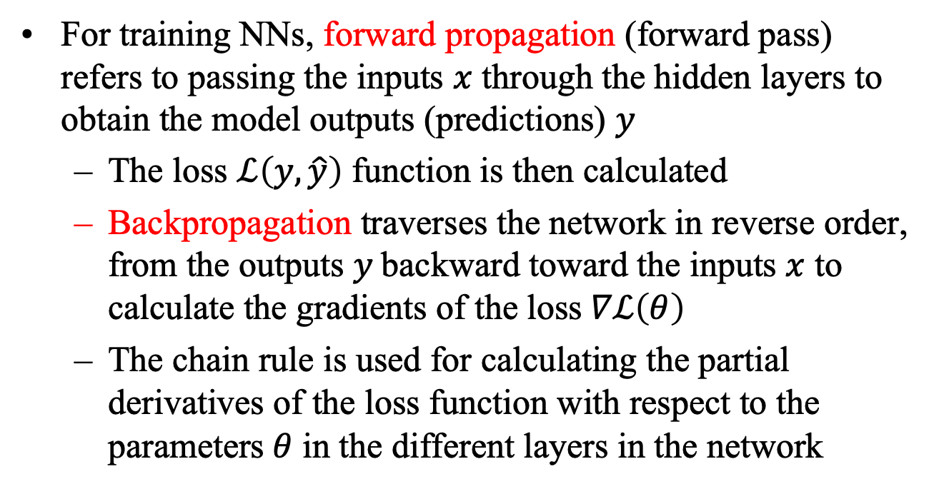
Backpropagation
For training NNs, forward propagation (forward pass) refers to passing the inputs $x$ through the hidden layers to obtain the model outputs (predictions) $y$
The loss $ℒ\left(y,\hat{y}\right)$ function is then calculated
Backpropagation traverses the network in reverse order, from the outputs $y$ backward toward the inputs $x$ to calculate the gradients of the loss$∇ℒ\left(θ\right)$
The chain rule is used for calculating the partial derivatives of the loss function with respect to the parameters$θ$ in the different layers in the network

Slide 34
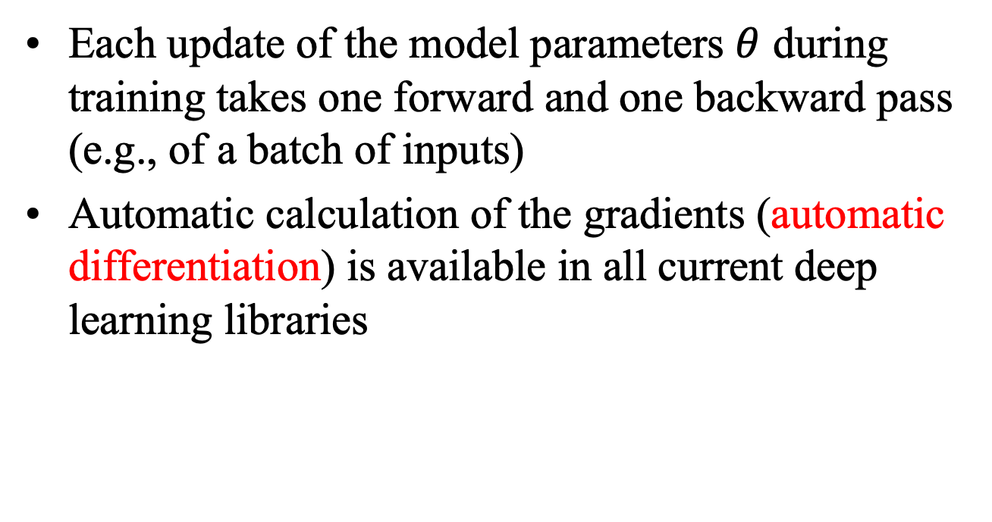
Backpropagation
Each update of the model parameters $θ$ during training takes one forward and one backward pass (e.g., of a batch of inputs)
Automatic calculation of the gradients (automatic differentiation) is available in all current deep learning libraries

Slide 35
Vanishing Gradient Problem
In some cases, during training, the gradients can become either very small (vanishing gradients) or very large (exploding gradients)
They result in very small or very large update of the parameters
Solutions: change learning rate, ReLU activations, regularization
……
y₁
……
y₂
……
……
……
……
……
……
y_{M}
Small gradients, learns very slow

Slide 36
regularization

Slide 37
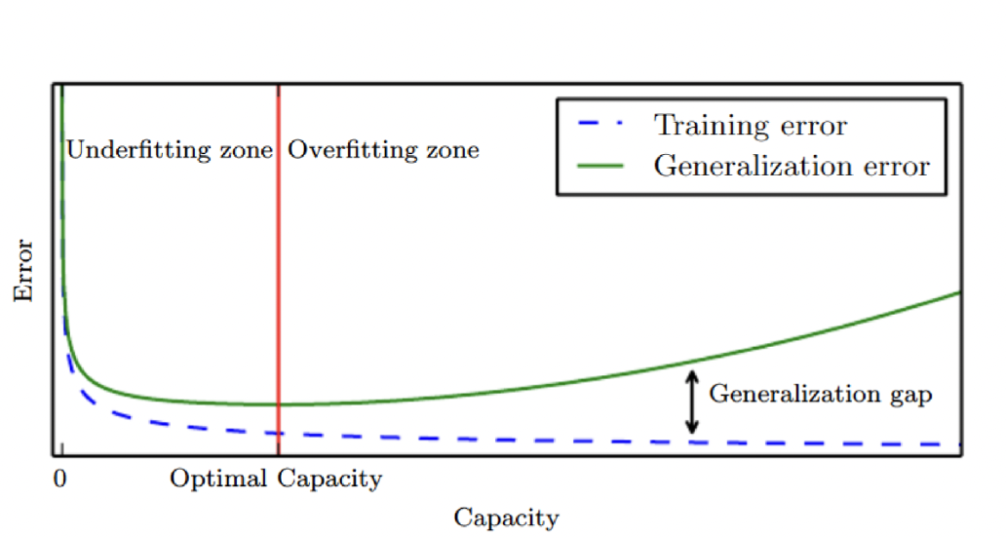
Regularization
The process of explicitly penalizing complex hypotheses
Any method to prevent overfitting
Any modification to a learning algorithm to reduce its generalization error but not its training error

Slide 38
Generalization error
Performance on inputs not previously seen
Also called as test error

Slide 39
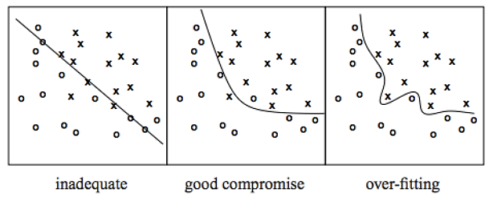
Overfitting
Overfitting – a model with high capacity fits the noise in the data instead of the underlying relationship

Slide 40
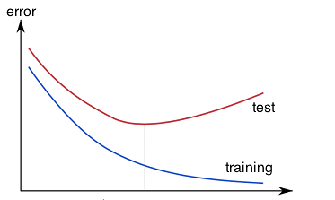
Overfitting
The model may fit the training data very well, but fails to generalize to new examples (test or validation data)

Slide 41
Multiple hidden layers
Coupling multiple units together into a network creates a complex function

Slide 42
Regularization: limiting number of hidden units
Number of hidden units M is a free parameter
Adjusted to get the best predictive performance

Slide 43
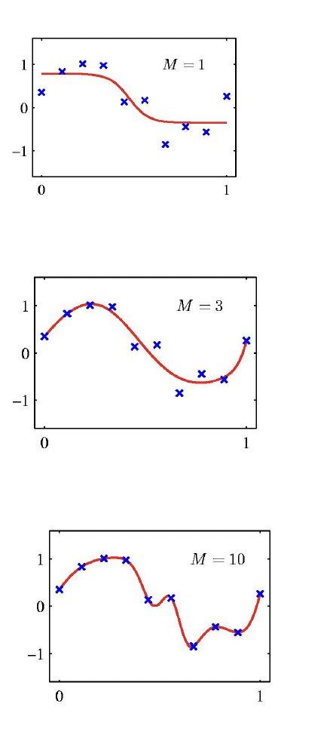
Effect of number of hidden units
Two - layer network trained on 10 data points
M = 1, 3, and 10 hidden units
Minimizing sum-of-squared error function using gradient descent
Generalization error is not a simple function of M
Due to the presence of local minima in the error function

Slide 44
Other ways to avoid overfitting
There are other ways to control the complexity of a neural network in order to avoid overfitting
Alternative approach
Choose a relatively large value of M and then control complexity by adding a regularization term

Slide 45
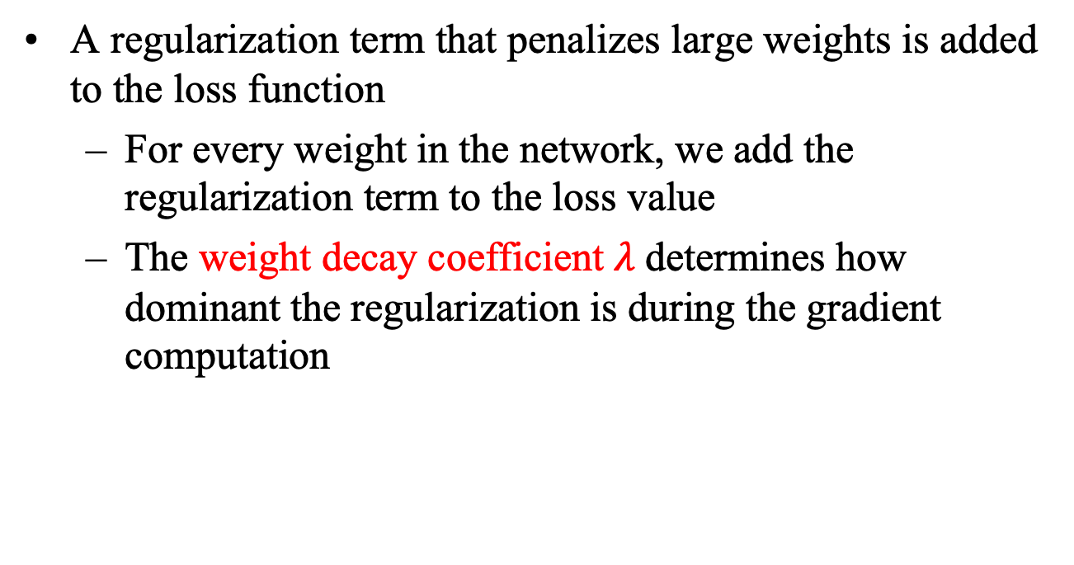
Regularization: Weight Decay
A regularization term that penalizes large weights is added to the loss function
For every weight in the network, we add the regularization term to the loss value
The weight decay coefficient $λ$determines how dominant the regularization is during the gradient computation

Slide 46
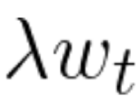
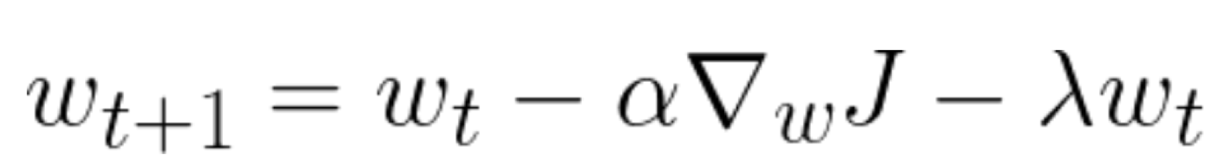
Weight Decay
Originally, we updated a weight with the gradient w.r.t w_{i},
With weight decay, we also subtract from the update:
Note: w_{i} = w_{t}

Slide 47
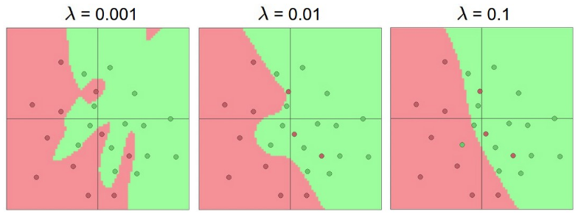

Regularization: Weight Decay
Effect of the decay coefficient $λ$
Large weight decay coefficient → penalty for weights with large values

Slide 48
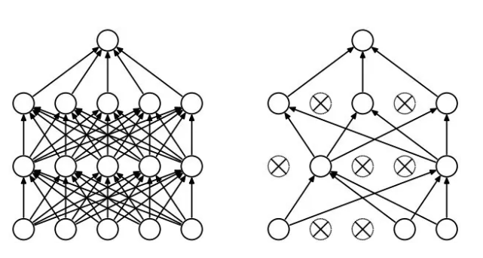
Regularization: Dropout
Randomly drop units (along with their connections) during training
Each unit is retained with a fixed dropout rate p, independent of other units
The hyper-parameter p needs to be chosen (tuned)
Often, between 20% and 50% of the units are dropped

Slide 49
Regularization: Dropout
Dropout is a kind of ensemble learning
Using one mini-batch to train one network with a slightly different architecture
minibatch
1
minibatch
2
minibatch
3
minibatch
n
……

Slide 50
Deep vs Shallow Networks
Deeper networks perform better than shallow networks
But only up to some limit: after a certain number of layers, the performance of deeper networks plateaus

Slide 51
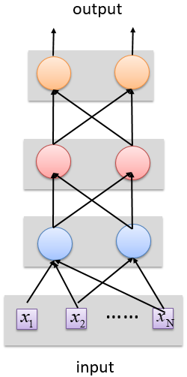
Shallow NN
Deep
NN
output
……
……
input

Slide 52
Convolutional Neural Networks

Slide 53
Reference
Deep learning
https://www.deeplearningbook.org/
Free book

Slide 54
Convolutional Neural Networks (CNNs)
CNNs were primarily designed for image data
CNNs use a convolutional operator for extracting data features
Allows parameter sharing
Efficient to train
Have less parameters than NNs with fully-connected layers
CNNs are robust to spatial translations of objects in images
A convolutional filter slides (i.e., convolves) across the image

Slide 55
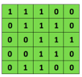

CNNs
Convolutional
3x3 filter
Input matrix

